Slide 1
How to Make a Map in ARCGIS online
Tutorial

Slide 2
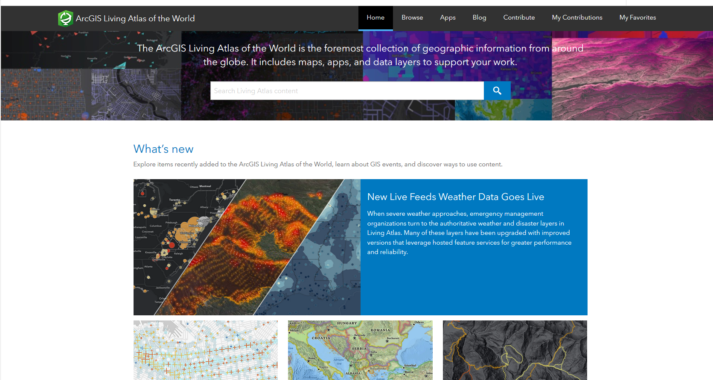
Where to Start? The Living Atlas!
The Living Atlas page, which is displayed to your right, will be the center for all your map, layer, and other content needs!
The Living Atlas is much like google, except for ArcGis Online. It gives any user the access to any map or layer data published. This is where you will be searching for maps to centralize your presentation/story map around.
To begin learning on how to use these maps, first click this link https://livingatlas.arcgis.com/en/ and continue following this tutorial!

Slide 3
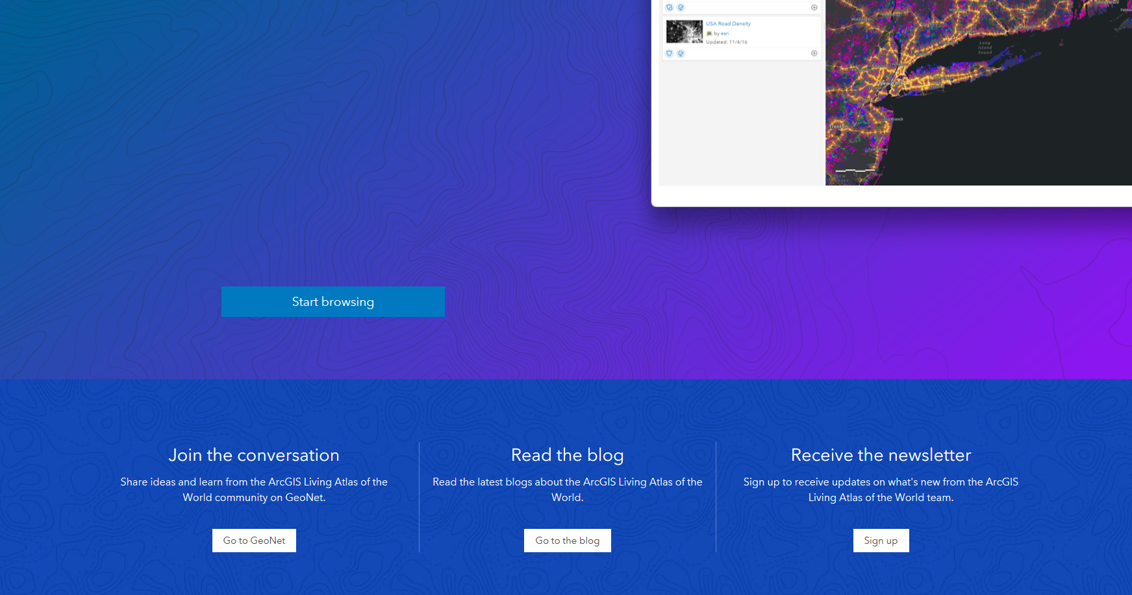
Content From the Living Atlas
From the Living Atlas page, you will scroll down until you see the start browsing option. It looks like the image to the right. By clicking on this you will be brought to the Living Atlas Search Engine.
You can also click this link :
https://livingatlas.arcgis.com/en/browse/#d=2&type=maps

Slide 4
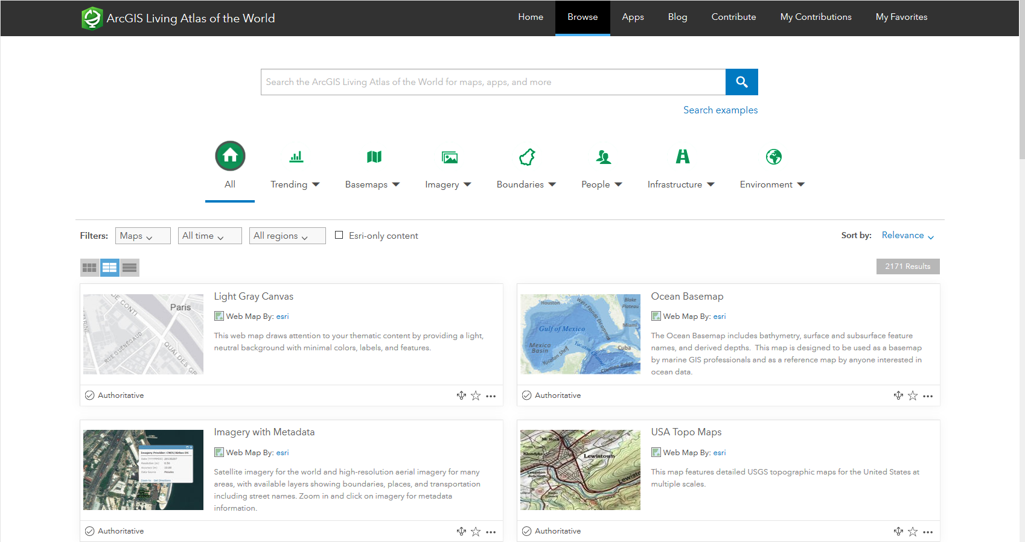
Content From the Living Atlas Cont...
This is the Living Atlas search engine. It allows ArcGIS Online users to access any published Maps, Layers, Story maps, and other data.
Now that you're here, there are many different options to select from to help you find the content you're looking for. You can interact with the webpage to the right to get started.
The first step when looking for content would be to determine what medium or media you are looking for. If you're looking for a map, you will need to select the map option in the "Filters" bar. You can use the different customization options at the top or type directly into the search bar to help you find content relating to a specific topic.

Slide 5
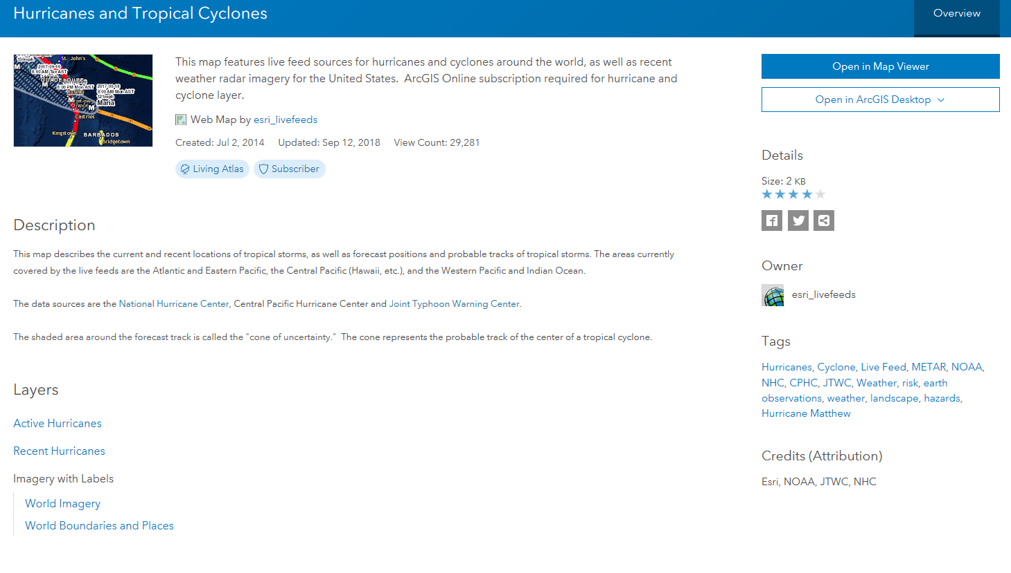
Downloading Content to your Account
Once you find the content you are looking for, you will need to click the title, bringing you to a page similar to this one. For this example, I was looking for a map regarding hurricanes. To begin the process of downloading this map, I will first need to "Open in Map Viewer" which is in the top right off this page.
This blue "Open" bar will read different options depending on the content you are downloading.

Slide 6
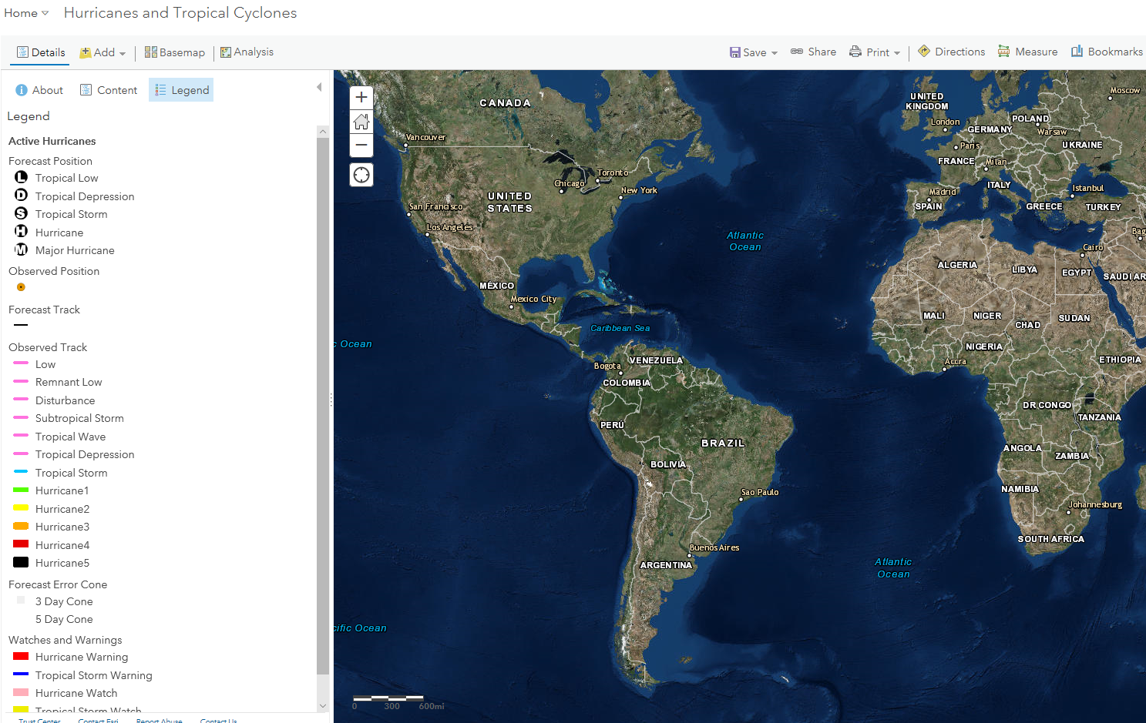
Downloading Content to your Account Cont...
Now that you have opened the content, you will be able to explore and determine if this is what you are really looking for.
If you have found content you are looking for, you will need to save it to your Organization/Account. The save option is in the top right of the task bar and looks like a floppy disk.
When you click save, you will be able to move the content into particular folders as well as under new names.
You can find your newly saved content in the "My Content" section of your account.

Slide 7
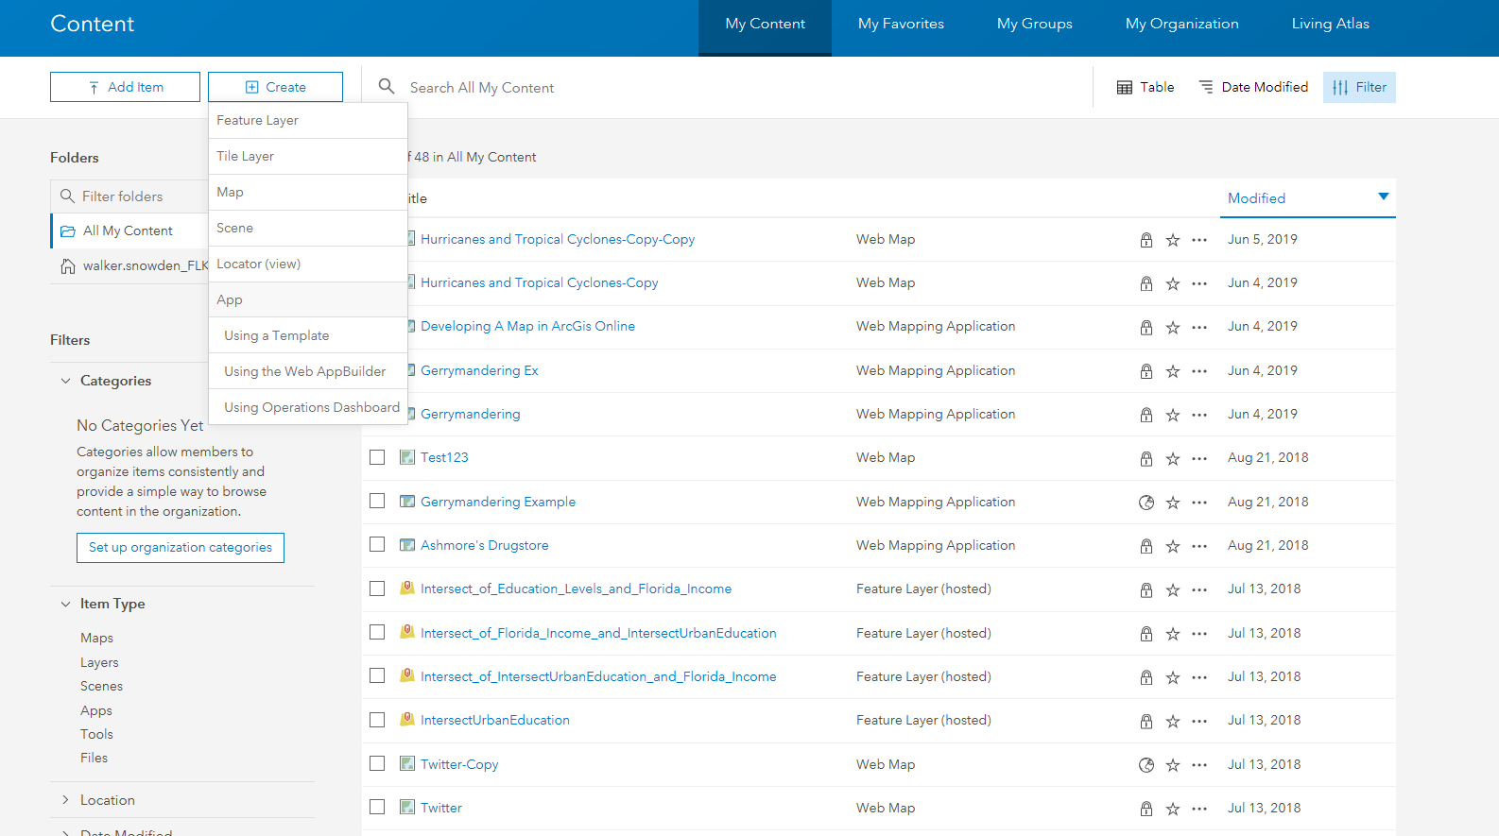
Creating and Editing Maps
To begin creating a map, you must go to the "My Content" page in your ArcGIS Online account.
You will then go to "create" in the top left corner of the screen, and click on "Map" that appears in the drop down menu.
A Title, Summary, and Tags are needed to create your map.

Slide 8
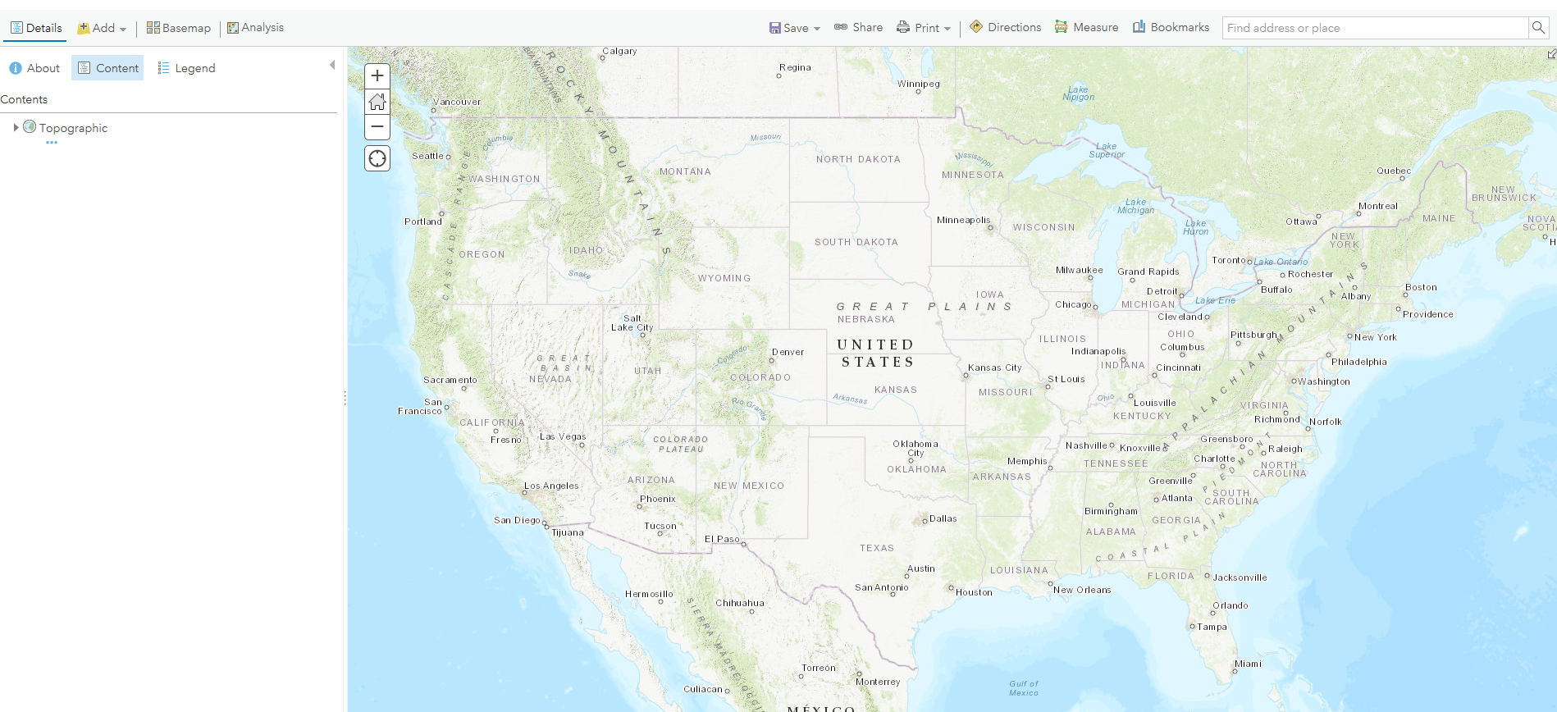
Creating and Editing Maps Cont...
The way the mechanisms work within a ArcGIS map is much like a pyramid. At the base of your pyramid is the "Basemap." The "Basemap" is the background of your map and can be changed at the top left of the task bar under "Basemap."
Once you have the base of your map, you can then add what are called "Layers" which will appear directly on top the Basemap.
When adding layers, you have many different options to chose from. The easiest way to find and use new layers is to search for them in the Living atlas. Once you find a layer in the Living atlas and save it to your content, you can then find the layer by clicking on "Search for Layers".

Slide 9
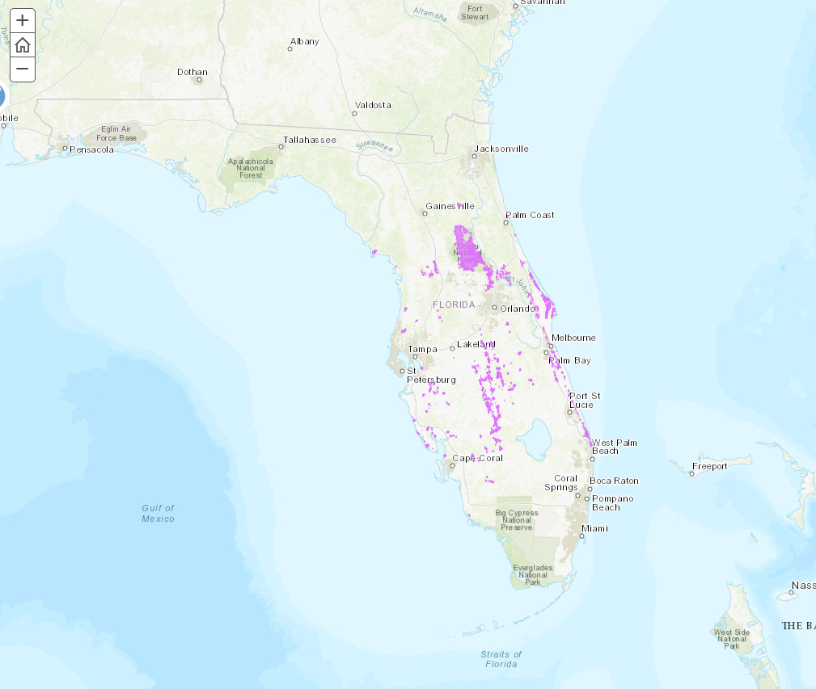
Creating and Editing Maps Cont...
Once you add a layer, it should appear on your basemap in some way. This map has a layer to show the existing Florida Scrub Jay habitats. This layer remains on top of the basemap. If another layer were added, it would appear on top of the previously added layer.
Layers are visual representations of data and have data attached to them. Layers can be customized in several different ways. Colors, shapes, and patterns can be customized to allow for different layers to become more distinguishable from one another.

Slide 10
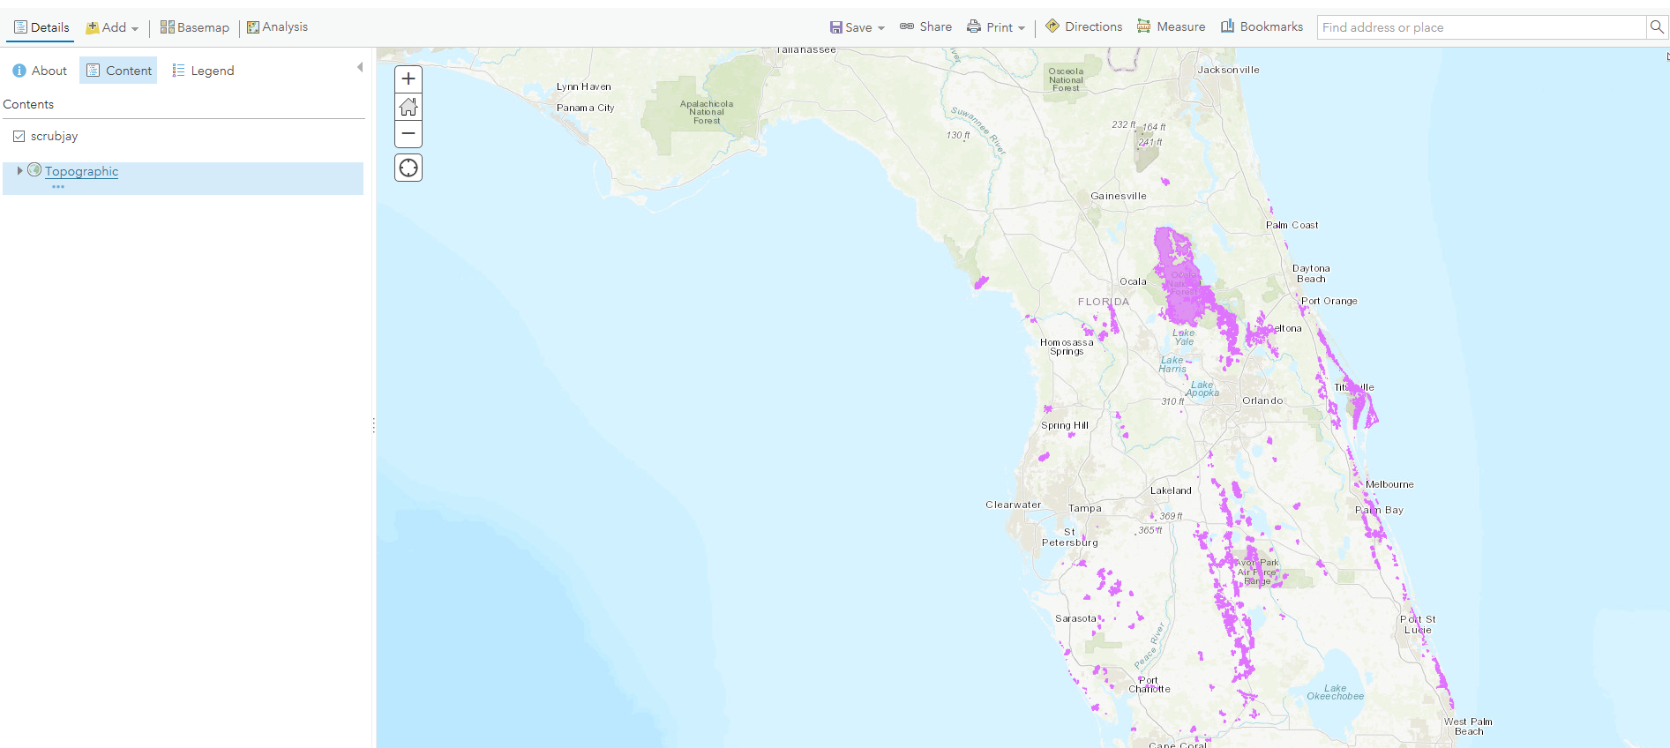
Editing Layers
Once a layer had been added to a map, by hovering your mouse over the layer name 6 images with be displayed below. These are options that allow the user to alter the layer. The titles of these options are, "Show Legend", "Show Table", "Change Style", "Filter", "Show Analysis."
Clicking on the "Show Legend" option will show the current visual settings for the layer.
The "Show Table" option will show a table of values associated with the layer at the bottom of the screen.
The "Change style" option (which looks like a circle/square/triangle) will allow the user to change the fill color and color outline of the layer as well as the shape.

Slide 11
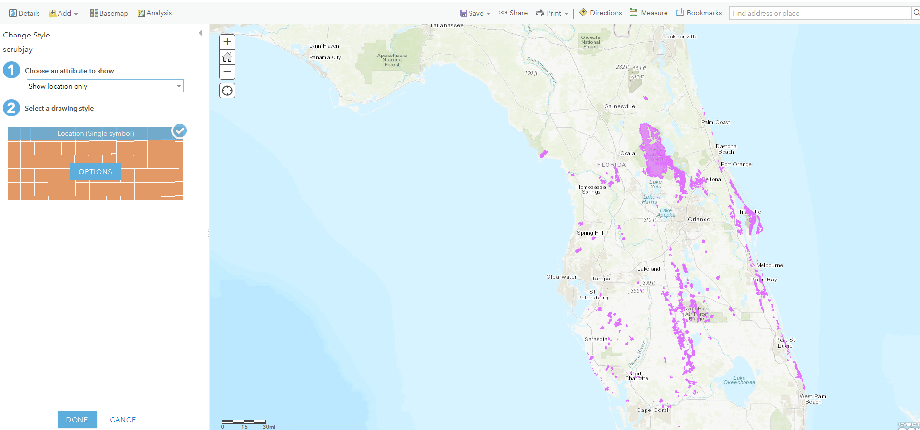
Editing: Change Style
When you click on "Change Style" you will be prompted two options. The second option, selecting a drawing style, will allow you to change the color as well as shape of your layer.

